Slide 1

Retail Demand Forecasting
Hackathon submission
By: Tarun Kummari
Date: 08-06-2024

Slide 2
Objective
Develop a demand forecasting model for a retail store chain that can that can predict future sales for each product category and store location. The model should incorporate factors like past sales data, promotions, holidays and demographics information.

Slide 3
Data Set Overview
Data generated is captured over time from different stores i.e. from 2013 – 01 – 01 to 2017 – 12 – 31. Every day total 500 records are generated at 10 different stores for 50 different products for 5 years (1826)days.
Total no of records 913000 (500*1826)
Data Fields
Date: Date of sales data
Store: Store Id
Item: Item Id
Sales: Number of items sold at a particular store on particular date

Slide 4
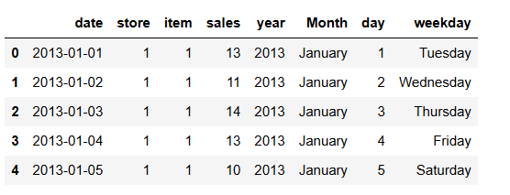
Feature Engineering
Extracted new features from the existing features to observe the trends and patterns in the data

Slide 5
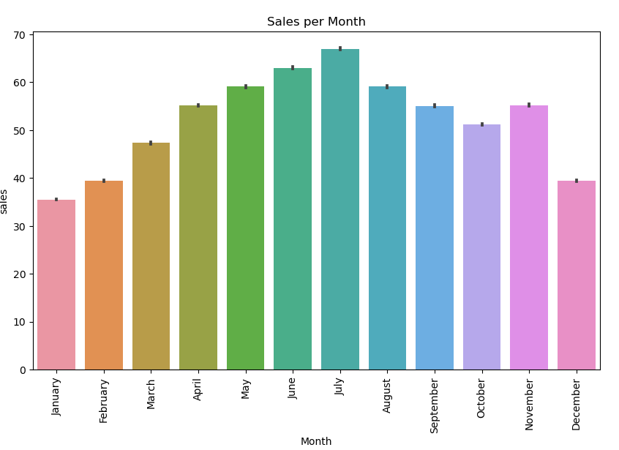
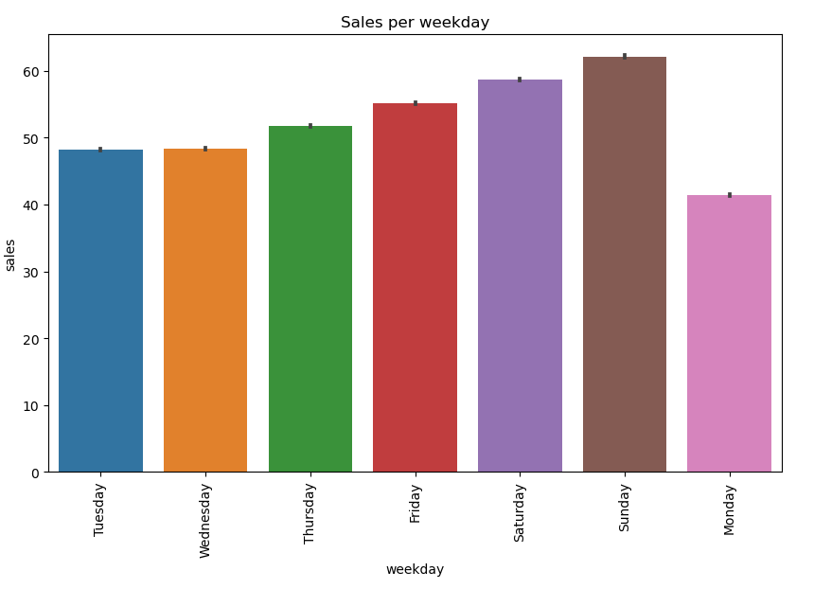
Exploratory data analysis

Slide 6
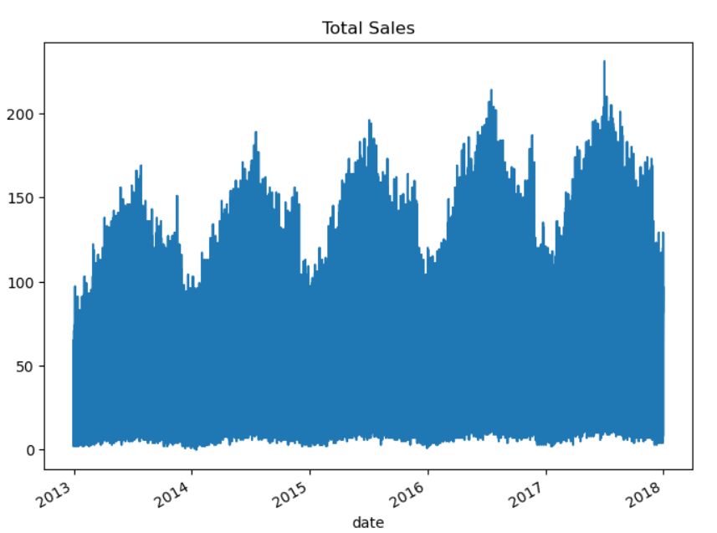
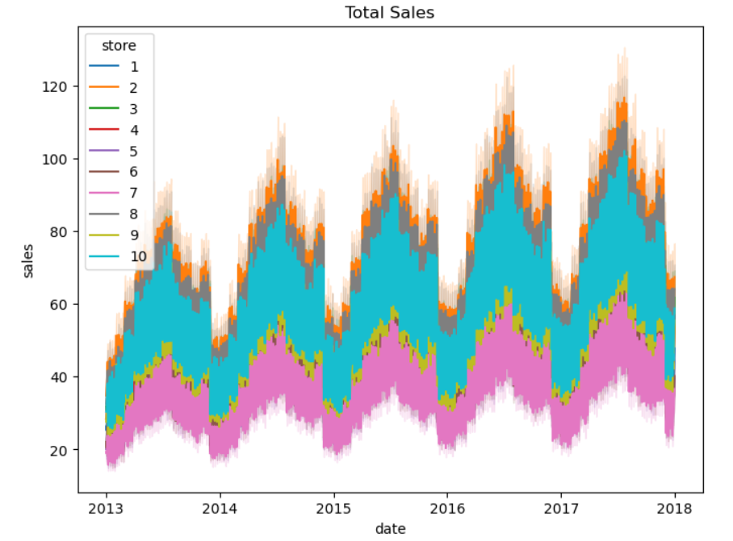

Slide 7
Model Building
Since the data is time series data used ARIMA model
The ARIMA (AutoRegressive Integrated Moving Average) model is a time series forecasting method that captures the linear relationship between an observation and a lagged set of observations, as well as any seasonality present in the data. It combines autoregression (AR), differencing (I), and moving average (MA) components to make predictions based on past values and forecast future values in a time series

Slide 8
Approach
As per the data we need to forecast based on the demographics of the store.
Step 1:
Splitted the data frame according to the store1
Step 2:
Build the forecasting model for each data frame
Step 3:
Tuned the models upon various model configurations to get the best possible results
Step 4:
Forecasted the test data

Slide 9
Recommendations
Upon finding and exploring insights from the data, it is evident that sales peak in the middle of every year. To sustain sales consistently throughout the entire year, implementing strategic offers, campaigns, or increasing advertisement efforts could help maintain momentum and capitalize on seasonal peaks.

Slide 10
THANK YOU

